Slide 2
Confusion Matrix
A confusion matrix is a performance evaluation tool in machine learning, representing the accuracy of a classification model.
A Confusion matrix is an N x N matrix.
It compares the predictions made by the model with the actual results and shows where the model was right or wrong.
It breaks down the predictions into four categories:

Slide 3
Four categories of CM:
The model correctly predicted a positive outcome i.e the actual outcome was positive.
True Positive (TP):
The model correctly predicted a negative outcome i.e the actual outcome was negative.
True Negative (TN):
False Positive (FP):
The model incorrectly predicted a positive outcome i.e the actual outcome was negative. It is also known as a Type I error.
False Negative (FN):
The model incorrectly predicted a negative outcome i.e the actual outcome was positive. It is also known as a Type II error.

Slide 4
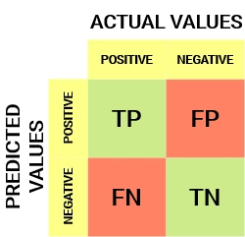
Representation of Confusion Matrix
A Confusion matrix is an N x N matrix.
Here, N = No. of Classes in CLA
Binary classification problem, we would have a 2 x 2 matrix.
2 x 2 matrix

Slide 5
Metrics based on Confusion Matrix Data
It helps to calculate key measures like Accuracy, Precision and Recall which give a better idea of performance especially when the data is imbalanced.

Slide 6

Accuracy:
Accuracy shows how many predictions the model got right out of all the predictions.
It gives idea of overall performance, but it can be misleading when one class is more dominant over the other.
Accuracy can be calculated using the below formula:

Slide 7

Precision
Precision tells us how many of the correctly predicted cases turned out to be positive.
Precision is a useful metric in cases where False Positive is a higher concern than False Negatives.
Precision is important in music or video recommendation systems, e-commerce websites, etc.
Wrong results could lead to customer churn and be harmful to the business.

Slide 8

Recall
Recall tells us how many of the actual positive cases we were able to predict correctly with our model.
Recall is a useful metric in cases where False Negative trumps False Positive.
Recall is important in medical cases where it doesn’t matter whether we raise a false alarm, but the actual positive cases should not go undetected!

Slide 9

F1-Score
F1-score is a harmonic mean of Precision and Recall, which combines precision and recall into a single metric to balance their trade-off.
It provides a better sense of a model’s overall performance particularly for imbalanced datasets.
It is helpful when both false positives and false negatives are important

Slide 10
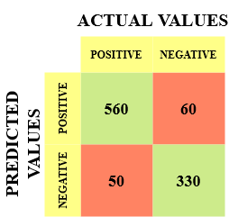
Example:
The different values of the Confusion matrix would be as follows:
True Positive (TP) = 560, meaning the model correctly classified 560 positive class data points.
True Negative (TN) = 330, meaning the model correctly classified 330 negative class data points.
False Positive (FP) = 60, meaning the model incorrectly classified 60 negative class data points as belonging to the positive class.
False Negative (FN) = 50, meaning the model incorrectly classified 50 positive class data points as belonging to the negative class.

Slide 11
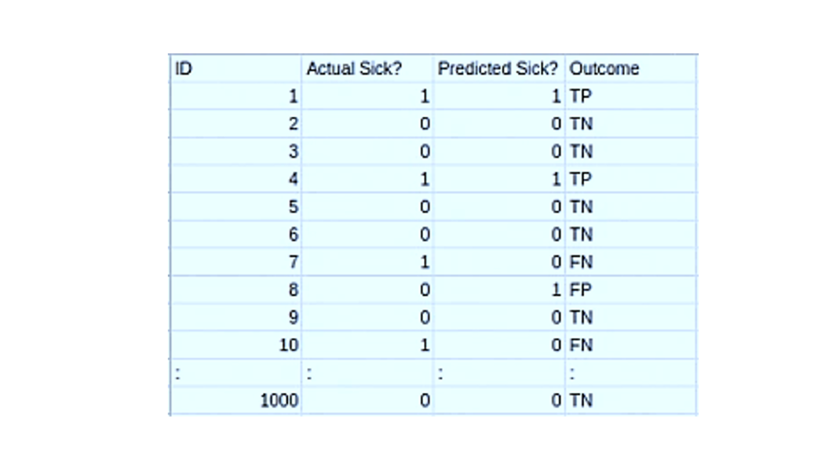
Find…????
Accuracy
Precision
Recall
F1-Score

Slide 12
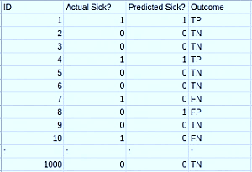

Slide 13
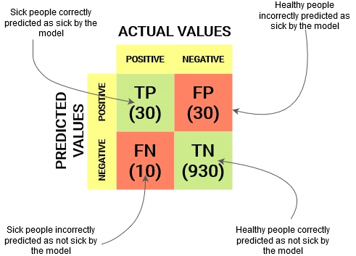
Find…????
1. Accuracy
2. Precision
3. Recall
4. F1-Score

Slide 14
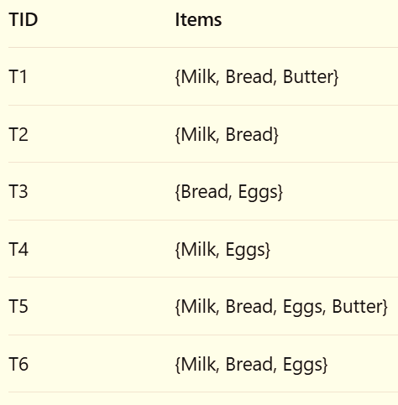
Question : Support Calculation & Itemset Pruning Given the following transaction database:
Assume a minimum support threshold (min_sup) of 50% (or 0.5).
a) Calculate the support for each individual item (1-itemset): {Milk}, {Bread}, {Butter}, {Eggs}. b) Which 1-itemsets are frequent? Create the set L₁. c) Generate all possible candidate 2-itemsets, C₂, from the frequent 1-itemsets. d) Calculate the support for each candidate in C₂. e) Which 2-itemsets are frequent? Create the set L₂. f) Generate the candidate 3-itemsets, C₃, using the join step from L₂. Hint: Remember the Apriori principle for pruning. g) Calculate the support for the candidates in C₃. Create the frequent 3-itemsets L₃.

Slide 15
Gain Ratio

Slide 16
Classification: Naïve Bayes’ Classifier
Naive Bayes is a probabilistic classification algorithms based on applying Bayes' Theorem with a strong (naive) assumption of independence between every pair of features.
Probabilistic: It calculates the probability of a data point belonging to each possible class and then assigns the class with the highest probability.
Naive: It "naively" assumes that all features (e.g., words in an email, symptoms of a disease) contribute independently to the probability of the class

Slide 17
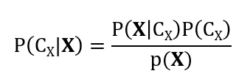

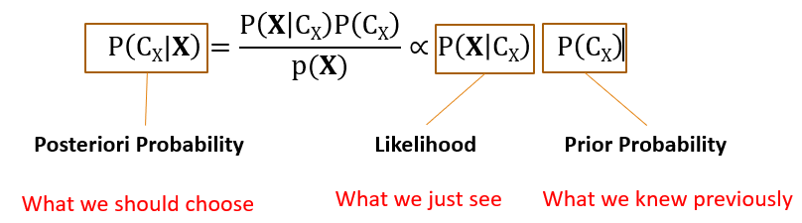
The Foundation: Bayes' Theorem
Bayes' Theorem describes the probability of an event, based on prior knowledge of conditions that might be related to the event.
X : Data Sample/Feature (“evidence”)
C_{X}: X belongs to class C

Slide 18
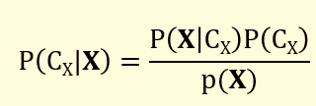
P(C_{X} |X) is the Posterior Probability. The probability of event C_{X} given that event X has occurred. (This is what we want to calculate).
P(X|C_{X}) is the Likelihood. The probability of event X given that event C_{X} is true.
P(C_{X}) is the Prior Probability. The initial probability of event C_{X}.
P(X) is the Evidence. The total probability of event.

Slide 19
Applying Bayes' Theorem to Classification
Bayes' Theorem for classification problem with features and a class.
We have:
A data point with multiple features: X = (x₁, x₂, x₃, ..., xₙ)
A set of possible classes: C = (C₁, C₂, ..., Cₖ)
Using Bayes' Theorem, we want to find the class Cᵢ for which the probability P(Cᵢ | X) is the highest-
P(Cᵢ | X) = [ P(X | Cᵢ) * P(Cᵢ) ] / P(X)

Slide 20
Step-by-Step Algorithm
Training Phase:
Calculate the Prior Probability, P(Cᵢ), for each class.
P(Cᵢ) = (Number of data points in class Cᵢ) (Total number of data points)
Calculate the Likelihood, P(Xⱼ|Cᵢ), for each feature Xⱼ given each class Cᵢ. This is done for every feature and every possible value of that feature.

Slide 21
2. Prediction Phase:
For a new, unseen data point with features
X = (x₁, x₂, ..., xₙ):
For each class Cᵢ:
Calculate the Posterior Numerator:
=P(C_{k}) * P(x₁ | C_{k}) * P(x₂ | C_{k}) * ... * P(xₙ | C_{k}) =P(C_{k}) * π [P(xi | C_{k})]….. For All k=1 to m
n
i=1
The class with highest Posterior Numerator
is the Predicted Class.
Notes:
i=1

Slide 22
Solved Example:
Dataset: Weather and Playing Cricket
Day | Outlook | Temperature | Humidity | Windy | PlayCricket
D1 | Sunny | Hot | High | False | No
D2 | Sunny | Hot | High | True | No
D3 | Overcast | Hot | High | False | Yes
D4 | Rain | Mild | High | False | Yes
D5 | Rain | Cool | Normal | False | Yes
D6 | Rain | Cool | Normal | True | No
D7 | Overcast | Cool | Normal | True | Yes
D8 | Sunny | Mild | High | False | No
D9 | Sunny | Cool | Normal | False | Yes
D10 | Rain | Mild | Normal | False | Yes
D11 | Sunny | Mild | Normal | True | Yes
D12 | Overcast | Mild | High | True | Yes
D13 | Overcast | Hot | Normal | False | Yes
D14 | Rain | Mild | High | True | No
Problem: Classify a new day with the features:
Outlook=Sunny, Temperature=Cool, Humidity=High, Wind=Strong. Will we play Cricket?

Slide 23
Step 1: Calculate Prior Probabilities P(Cᵢ)
We have two classes: Yes and No.
Total days: 14
Days with "Yes": → 9
Days with "No": → 5
Probability of Yes → P(Yes) = 9/14
Probability of No → P(No) = 5/14

Slide 24
Step 2: Calculate Likelihoods P(xⱼ | Cᵢ)
likelihood for each feature w.r.t the given class in CLA.
For Class = Yes:
P(Outlook=Sunny | Yes) = (Number of "Yes" days with Sunny)
(Total "Yes" days)
= 2/9
As per the Problem Calculate Probability of given Feature for class “YES”-
Temperature=Cool, Humidity=High, Wind=Strong
P(Temperature=Cool | Yes) = 3/9
P(Humidity=High | Yes) = 3/9 ;P(Wind=Strong | Yes) = 3/9

Slide 25
For Class = No:
P(Outlook=Sunny | No) = (Number of “No" days with Sunny)
(Total “No" days)
= 3/5
As per the Problem Calculate Probability of given Feature for class “No”-
Temperature=Cool, Humidity=High, Wind=Strong
P(Temperature=Cool | No) = 1/5
P(Humidity=High | No) = 4/5 ;
P(Wind=Strong | No) = 3/5

Slide 26
Step 3: Make a Prediction for the New Day
Our new data point is:
X = (Outlook=Sunny, Temperature=Cool, Humidity=High, Wind=Strong)
We calculate the posterior numerator for both classes.
For Class = Yes:
P(Yes) * P(Sunny | Yes) * P(Cool | Yes) * P(High | Yes) * P(Strong | Yes)
= (9/14) * (2/9) * (3/9) * (3/9) * (3/9)
= 0.642 * 0.222 * 0.333 * 0.333 * 0.333
≈ 0.0053

Slide 27
For Class = No:
P(No) * P(Sunny | No) * P(Cool | No) * P(High | No) * P(Strong | No)
= (5/14) * (3/5) * (1/5) * (4/5) * (3/5)
= 0.357 * 0.6 * 0.2 * 0.8 * 0.6
= 0.0205
Step 4: Compare and Conclude
Posterior Numerator for "Yes" ≈ 0.0053
Posterior Numerator for "No" ≈ 0.0205
Since 0.0205 > 0.0053, the model predicts that we should NOT play Cricket on this day.

Slide 28
Self Exercise Question
Apply Naïve Base Classifier on Customer Database.
Query:
IF
Age (Senior) | Income(High) | Student(No) | Credit_Rating(Fair)
Then,
Will a Customer Buy a Computer or, Not??

Slide 29
NBC: Customer Database
CLA
RID | Age | Income | Student | Credit_Rating | Buys_Computer
R1 | youth | high | no | fair | no
R2 | youth | high | no | excellent | no
R3 | middle_aged | high | no | fair | yes
R4 | senior | medium | no | fair | yes
R5 | senior | low | yes | fair | yes
R6 | senior | low | yes | excellent | no
R7 | middle_aged | low | yes | excellent | yes
R8 | youth | medium | no | fair | no
R9 | youth | low | yes | fair | yes
R10 | senior | medium | yes | fair | yes
R11 | youth | medium | yes | excellent | yes
R12 | middle_aged | medium | no | excellent | yes
R13 | middle_aged | high | yes | fair | yes
R14 | senior | medium | no | excellent | no

Slide 30
K-Nearest Neighbor (KNN) Classifier
KNN used for both classification and regression tasks, However, it is mostly used for classification.
K-Nearest Neighbour (KNN) is one of the simplest and most popular supervised, Distance-based, non-parametric, lazy Learner learning algorithm.

Slide 31
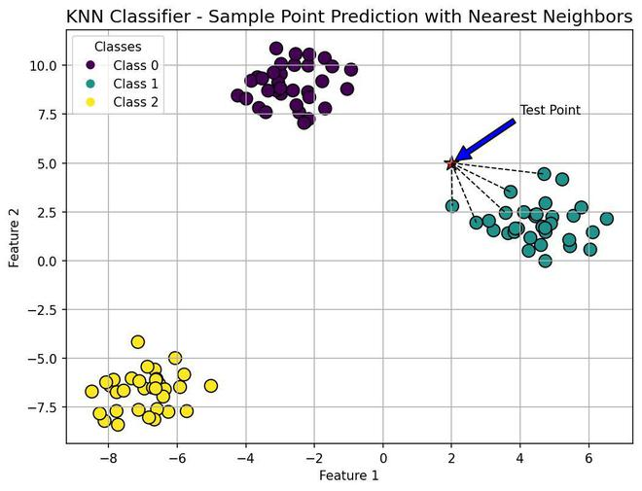
Supervised: It requires a labeled dataset to learn from.
Distance-based:
To classify the test data, KNN finds minimum distance among K-nearest data points from Training data set.
There are Three Ways to Measure the Distance function in KNN:
Euclidian Dist.
Manhattan Dist.
Mankowski Dist.

Slide 32
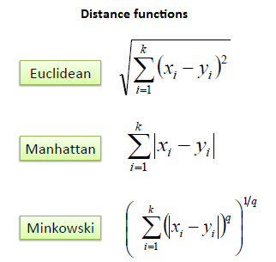
When q = 2
When q = 1
When q = Random Variable

Slide 33
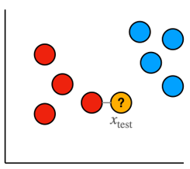

Non-parametric:
Lazy learning algorithms like K-NN are useful when the data is noisy or has a complex structure.
Algorithms like KNN are considered as non-parametric when It doesn't make any assumptions about the underlying data distribution.
(e.g., it doesn't assume data is normally distributed). This makes it very flexible.
Random Distribution of Data

Slide 34
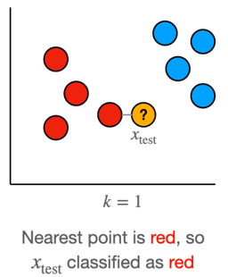
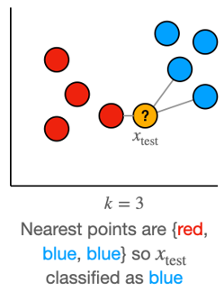
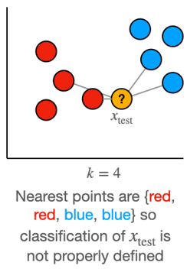
Lazy Learner :
K-Nearest Neighbors (KNN) is called a lazy learner because it doesn’t build any model during training. It just stores all the training data, and when a new sample appears, it finds the K nearest points from the stored data and assigns the class that most of those neighbors belong to.

Slide 35
How the K-NN Algorithm Works:
The algorithm executes in three simple steps.
Let's assume we have a training dataset with features like (Feature 1, Feature 2,…) and a Class label like (Category A , Category B,..).
Step 1: Load the Data and Choose K.
select a value for K, which is the number of nearest neighbors to consider.
Value of K is very Sensitive and Crucial for results optimization.

Slide 36
Step 2: Calculate the Distance.
When a new, unlabeled data point (the ".query point") comes in, the algorithm calculates the distance between this new point and every single point in the training dataset.
Euclidean Distance Metrics used to calculate the distance among data points.
Formula (2D):
Distance = √[(x₂ - x₁)² + (y₂ - y₁)²]

Slide 37
Step 3: Identify Neighbors and Vote
Sorts all the training data points by their distance to the new point (from smallest to largest).
Now Picks the top K points from this sorted list. These are the "K-Nearest Neighbors."
Finally, Note the class labels of these K neighbors.
The new data point is Classify to the class that has the majority vote among its K neighbors.

Slide 38
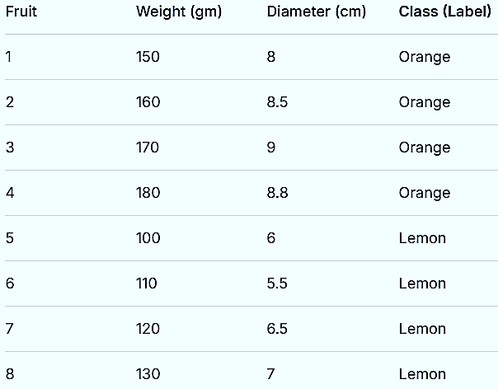
KNN Example: Classifying Fruits

Slide 39
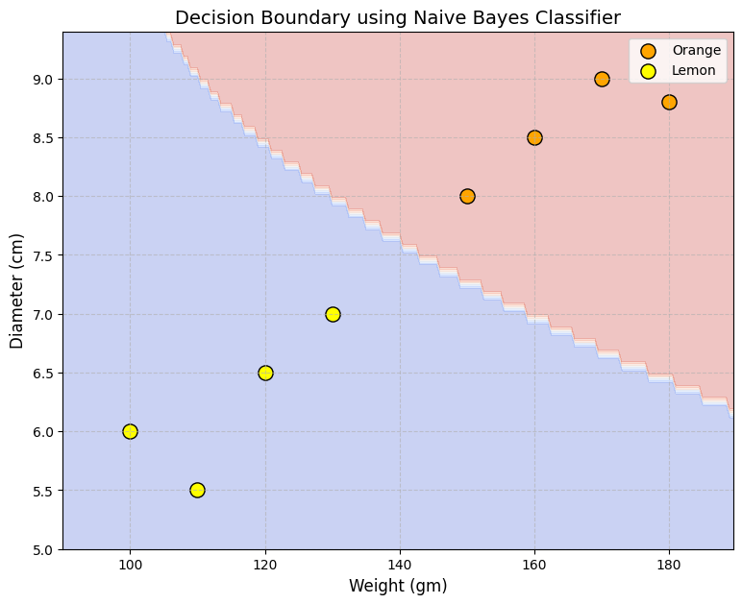
Visualizing the Data: (Imagine this plot)
X-axis: Weight; Y-axis: Diameter
Oranges are clustered in the top-right (heavier, larger).
Lemons are clustered in the bottom-left (lighter, smaller).

Slide 40
Problem Statement: We have a new fruit with:
Weight = 140 gm
Diameter = 7.5 cm
What is it, an Orange or a Lemon???
Now Plot this New Fruit at (X,Y)- Coordinates
New Fruit

Slide 41
Step 1: Choose K
Let's start with K = 3
Step 2: Calculate Euclidean Distance We calculate the distance from our new point (140, 7.5) to every point in the training set.
Distance to
Orange 1 (150, 8):
√[(140-150)² + (7.5-8)²]
= √[(-10)² + (-0.5)²]
= √[100 + 0.25]
= √100.25 ≈ 10.01
Distance to
Orange 2 (160, 8.5):
√[(140-160)² + (7.5-8.5)²]
= √[(-20)² + (-1)²]
= √[400 + 1]
= √401 ≈ 20.02

Slide 42
all calculated distances:
Fruit | Class | Distance to (140, 7.5)
1 | Orange | 10.01
2 | Orange | 20.02
3 | Orange | 30.04
4 | Orange | 40.01
5 | Lemon | 41.11
6 | Lemon | 50.02
7 | Lemon | 20.62
8 | Lemon | 10.31

Slide 43
Step 3: Find Nearest Neighbors and Vote
Now, we sort the data by distance (ascending order) and pick the top K=3 neighbors.
Our 3-Nearest Neighbours are: Fruit 1 (Orange), Fruit 8 (Lemon), Fruit 7 (Lemon).
Now, we take a vote:
Orange: 1 vote
Lemon: 2 votes
Result: By majority vote, the new fruit (140, 7.5) is classified as a Lemon.
What if we change K? Let's try K=5

Slide 44
Self Exercise Question: KNN Classifier
The dataset below has two features: Income (in ₹ thousands) and Age (in years). The task is to predict if a person will buy a car (Yes/No).
Person | Income | Age | Buys Car
A | 25 | 25 | No
B | 30 | 35 | No
C | 45 | 40 | Yes
D | 50 | 50 | Yes
E | 60 | 60 | Yes
A new person P(Income = 40, Age = 30) wants to be classified using:
K = 3
Euclidean distance
Z-score normalization for each feature

